Slide 1
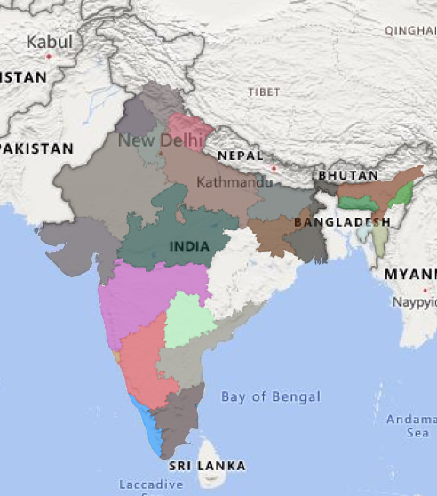
Humanitarian Risk Analytics
An Integrated Dashboard Project Using SQL, Python, ML, and Power BI
Saurabh sagar
August 2025
Turning data into direction for vulnerable communities

Slide 2
Executive Summary
Synthesizing Poverty-Weighted Food Price Insights for Humanitarian Decision-Making
This project analyzes poverty-weighted food prices across Indian markets to identify regions facing disproportionate economic stress. It integrates SQL cleaning, Python modeling, and Power BI dashboarding to deliver actionable insights for humanitarian response.
Key Findings
Bihar shows highest price burden
Rice and wheat are most volatile
Cluster 1 reveals compounded vulnerability
Outliers flag hidden stress zones
Impact
Policy targeting based on spatial and commodity-specific risk
Scalable reporting for humanitarian agencies and state governments
A replicable model for risk analytics in other regions or sectors

Slide 3

Project Overview
From Raw Data to Humanitarian Insight
This project analyzes poverty-weighted food prices across India using a structured, multi-phase workflow. From SQL-based data cleaning to machine learning clustering and Power BI dashboarding, each phase builds toward actionable insights for humanitarian decision-making.
Phases:
Project Setup – Folder structure, reproducibility, documentation
Data Cleaning & SQL Setup – Normalize, filter, and join datasets
Exploratory Analysis – Price trends, poverty correlations
ML Modelling – Regression, clustering, SHAP interpretation
Dashboarding – Interactive visuals, slicers, annotations
AI-Augmented Reporting – Executive summaries, policy framing
Final Report – PowerPoint deck with visuals and insights

Slide 4
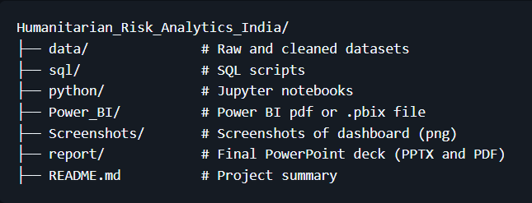
Folder Structure and Workflow Setup
Organized for Reproducibility and Collaboration
Folder Structure
Project Setup – Folder structure, reproducibility, documentation
Data Cleaning & SQL Setup – Normalize, filter, and join datasets
Exploratory Analysis – Price trends, poverty correlations
ML Modelling – Regression, clustering, SHAP interpretation
Dashboarding – Interactive visuals, slicers, annotations
AI-Augmented Reporting – Executive summaries, policy framing
Final Report – PowerPoint deck with visuals and insights
This structure supports modular development across SQL, Python, and Power BI. Each phase is documented and version-controlled, enabling reproducibility and collaboration. The Report/ folder houses the final PowerPoint deck, while README.md and CHANGELOG.md track project evolution.

Slide 5
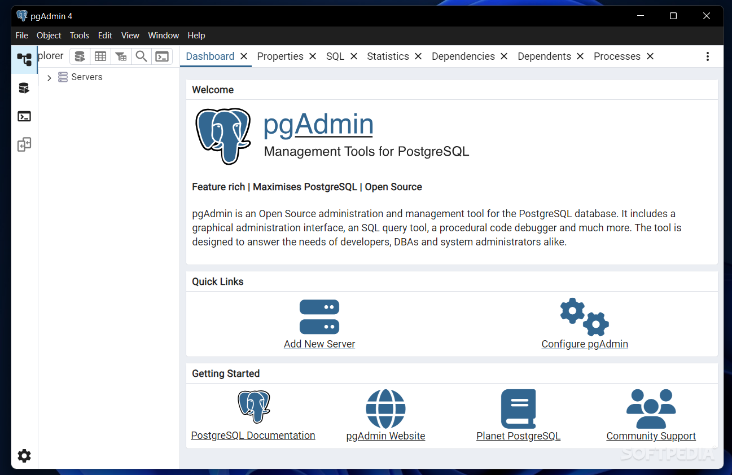
SQL Phase: Cleaning & Integration
Structuring Food Price and Poverty Data for Analysis
This project analyzes poverty-weighted food prices across India using a structured, multi-phase workflow. From SQL-based data cleaning to machine learning clustering and Power BI dashboarding, each phase builds toward actionable insights for humanitarian decision-making.
The SQL phase focused on transforming raw food price and poverty datasets into a clean, analysis-ready format. Key steps included:
Dropping rows with missing or zero prices
Normalizing units (e.g., per kg/liter)
Standardizing date formats
Filtering to recent years (2015–2025)
Cleaning poverty indicators and aligning time periods
Joining datasets on provider_admin1_name and reference_period_start

Slide 6
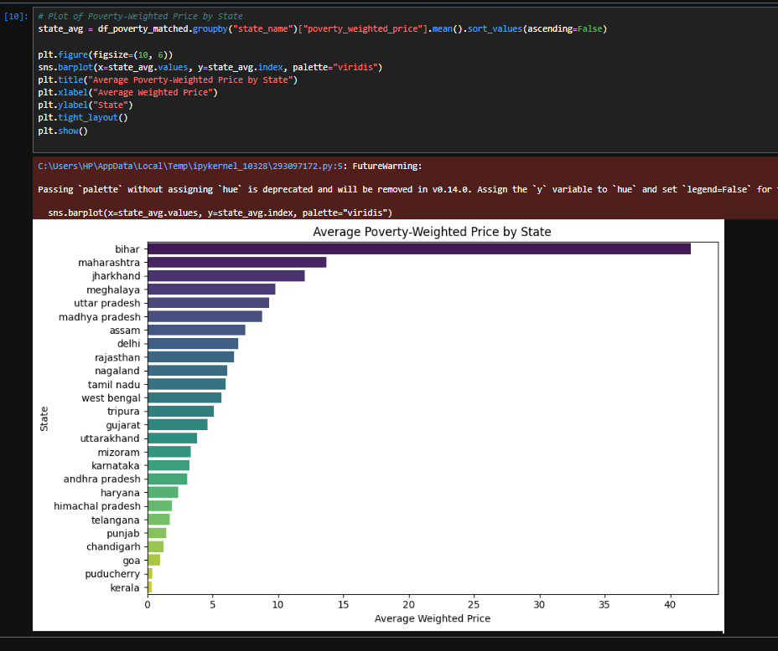
EDA: Price Trends & Poverty Correlations
Early Insights from Python Notebooks
Using Python (pandas, matplotlib, seaborn), we explored food price trends across states and their relationship to poverty indicators
Key insights include:
Bihar shows consistently high poverty-weighted food prices
Volatility is highest in rice, wheat, and sugar
Positive correlation between MPI and price-to-poverty ratio
Certain states (e.g., Jharkhand, Odisha) show price spikes despite moderate poverty

Slide 7
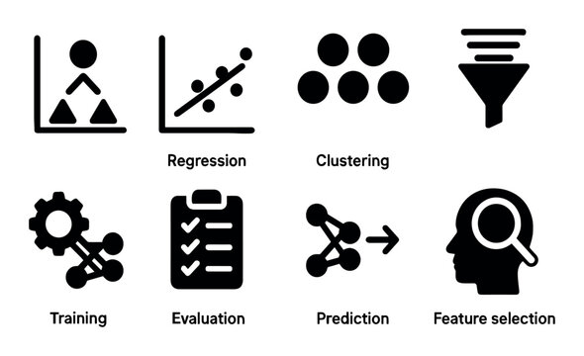
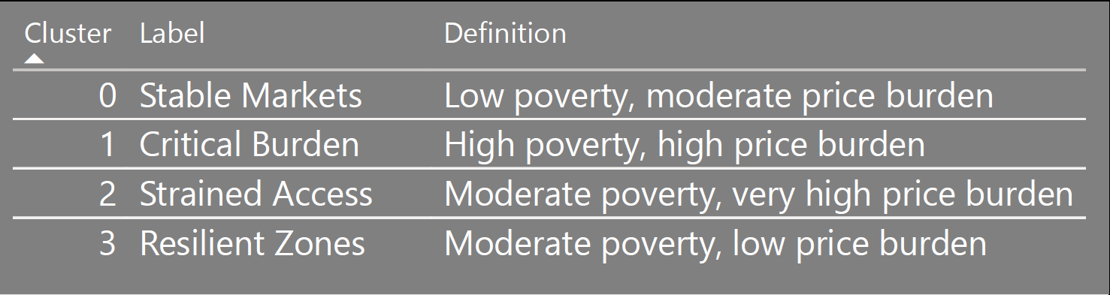
ML Modeling: Vulnerability Clusters & Risk Drivers
Using KMeans and SHAP to Surface Humanitarian Stress
Using Python (pandas, matplotlib, seaborn), we explored food price trends across states and their relationship to poverty indicators
Machine learning was used to segment markets and explain price burden dynamics:
KMeans Clustering grouped markets into 4 vulnerability profiles based on MPI, poverty ratio, and price burden indicators
Cluster 1 (“Critical Burden”) revealed markets with deep poverty and high food prices
SHAP Analysis explained which features most influenced price-to-poverty ratio—MPI and volatility were top drivers

Slide 8
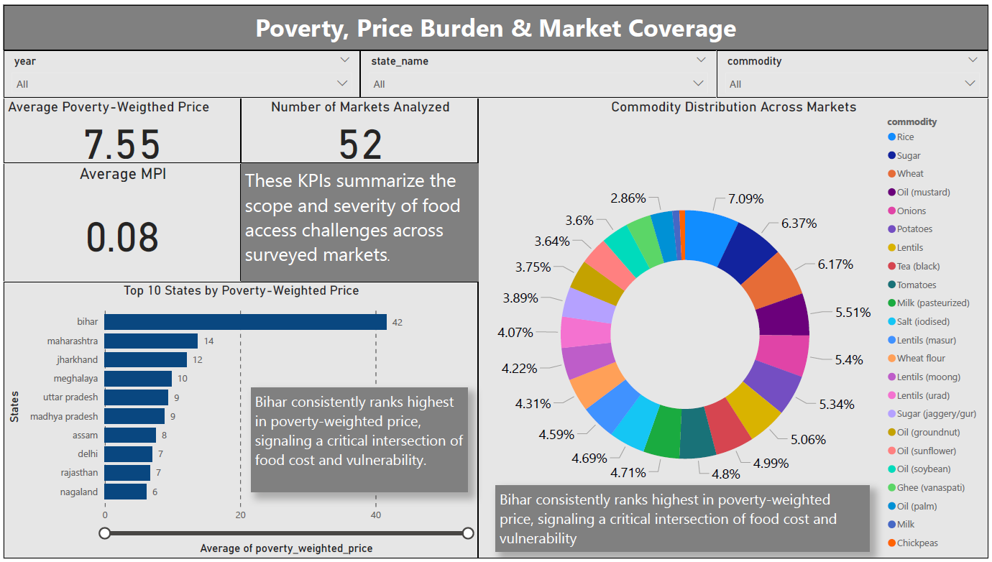
Dashboard Overview: National Trends & KPI Highlights
Poverty-Weighted Food Prices Across India

Slide 9
Key Insights from Overview Dashboard
Poverty-Weighted Food Prices Across India
Key Findings:
Bihar shows the highest poverty-weighted price burden across all states
Rice and wheat dominate consumption but show price volatility in vulnerable regions
KPI cards highlight average MPI, price-to-poverty ratio, and top 5 vulnerable states
Pie chart reveals commodity distribution, with rice and wheat comprising the majority
Implications & Suggested Actions:
Prioritize Bihar and Jharkhand for price stabilization programs
Monitor rice and wheat markets for volatility spikes
Consider expanding poverty data collection in underrepresented regions
Use dashboard KPIs for monthly humanitarian risk tracking

Slide 10
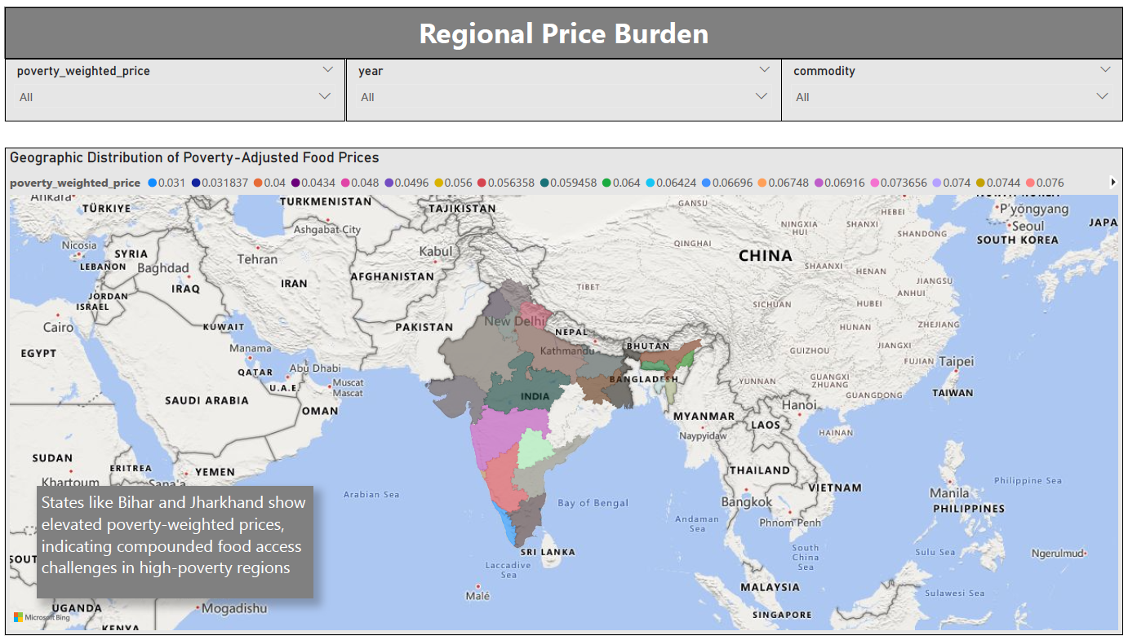
Dashboard Preview: Vulnerability Map
Mapping Poverty-Weighted Price Burden Across India

Slide 11
Key Insights from Vulnerability Map
Mapping Poverty-Weighted Price Burden Across India
Key Findings:
Bihar, Jharkhand, and Odisha show consistently high poverty-weighted prices
Southern states (e.g., Kerala, Tamil Nadu) show lower burden despite high prices
Spatial clustering reveals regional disparities in affordability
Commodity filters show rice and wheat as dominant drivers in high-risk zones
Implications & Suggested Actions:
Prioritize eastern states for price stabilization and poverty relief
Use spatial insights to target food distribution and subsidy programs
Monitor commodity-specific stress in high-burden regions
Consider integrating district-level poverty data for finer granularity

Slide 12
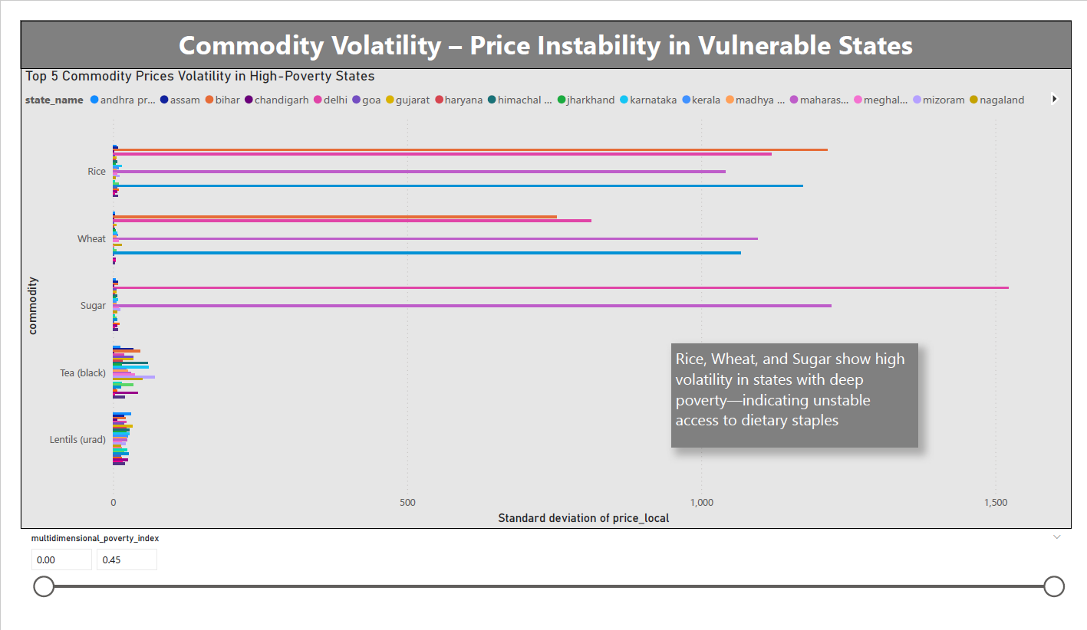
Dashboard Preview: Volatility Chart
Identifying Price Instability in Vulnerable Markets

Slide 13
Key Insights from Volatility Chart
Identifying Price Instability in Vulnerable Markets
Key Findings:
Rice, wheat, and sugar show the highest volatility across multiple states
Bihar and Jharkhand experience frequent price spikes in core staples
Volatility is not uniform—some states show stable prices despite poverty
Seasonal patterns may influence volatility in certain commodities
Implications & Suggested Actions:
Prioritize price monitoring systems for volatile staples in high-poverty regions
Consider buffer stock policies or subsidies for rice and wheat
Use volatility insights to time interventions (e.g., pre-harvest or lean season)
Recommend commodity-specific dashboards for deeper tracking

Slide 14
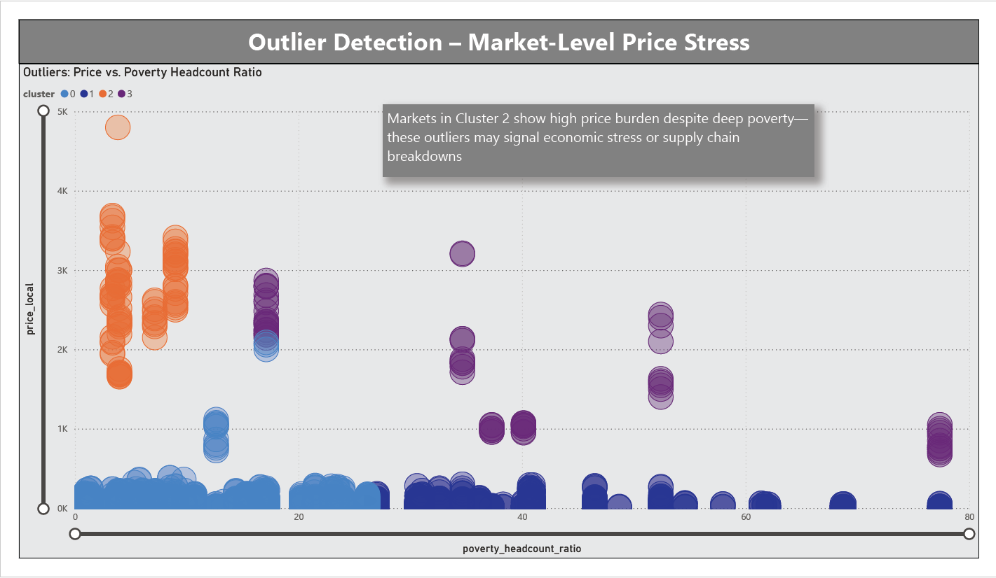
Dashboard Preview: Outlier Detection
Identifying Deviations in Poverty-Price Relationships

Slide 15
Key Insights from Outlier Detection
Identifying Deviations in Poverty-Price Relationships
Key Findings:
Several markets show high price-to-poverty ratios despite moderate MPI
Outliers are concentrated in Bihar, Uttar Pradesh, and Chhattisgarh
Some commodities (e.g., sugar, pulses) show unexpected spikes in specific regions
These outliers may reflect supply chain disruptions or local inflation shocks
Implications & Suggested Actions:
Flagged markets should be prioritized for field validation and monitoring
Consider deploying targeted subsidies or price caps in outlier zones
Use outlier detection to refine early warning systems for humanitarian stress
Recommend integrating real-time market data to improve responsiveness

Slide 16
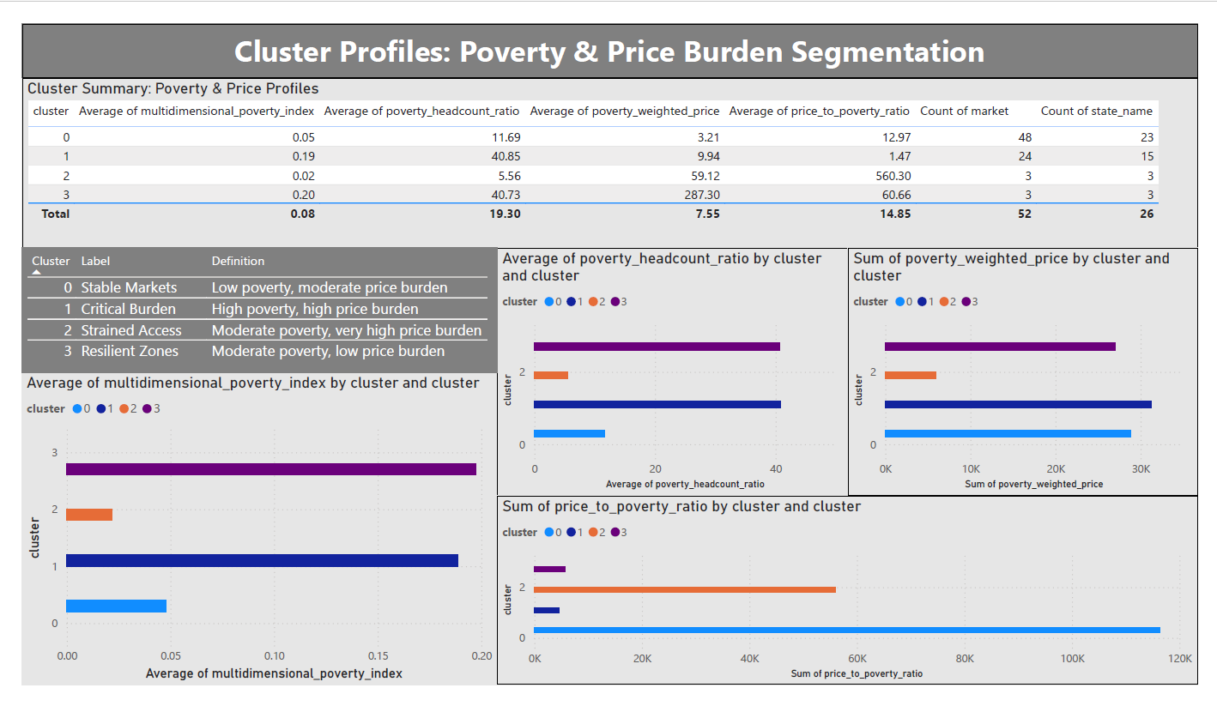
Dashboard Preview: Vulnerability Clusters
Clustering Markets by Poverty & Price Burden

Slide 17
Key Insights from Vulnerability Clusters
Clustering Markets by Poverty & Price Burden
Key Findings:
Cluster 1 (“Critical Burden”) includes markets with high poverty and elevated food prices
Cluster 2 (“Strained Access”) shows very high price burden despite moderate poverty
Cluster 0 (“Stable Markets”) reflects low poverty and manageable prices
Clustering reveals distinct risk profiles across regions—enabling targeted response
Implications & Suggested Actions:
Use cluster labels to prioritize humanitarian interventions
Recommend price stabilization in Cluster 1 zones
Monitor Cluster 2 for emerging stress despite moderate poverty
Share cluster definitions with stakeholders for policy alignment and targeting

Slide 18
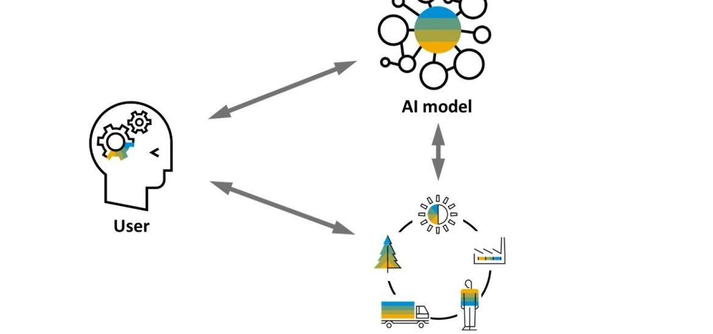

AI-Augmented Summary
Synthesizing Insights for Decision-Makers
Copilot-generated insights from dashboard analysis reveal:
Cluster 1 markets face compounded risk—deep poverty and elevated food prices
Volatility in core staples (rice, wheat) amplifies humanitarian stress
Outlier markets may signal emerging crises or data gaps
Spatial and commodity filters enable targeted monitoring and response
This dashboard enables:
Prioritization of high-risk zones for policy intervention
Commodity-specific planning for food security programs
Scalable reporting for humanitarian agencies and state governments
A replicable model for risk analytics in other regions

Slide 19
Policy Recommendations
Targeted Actions Based on Dashboard Insights
Strategic Recommendations
Stabilize prices in Cluster 1 markets through targeted subsidies
Monitor rice and wheat volatility in high-poverty states like Bihar and Jharkhand
Expand poverty data collection in underrepresented regions for better targeting
Deploy early warning systems using outlier detection and volatility tracking
Use dashboard KPIs for monthly humanitarian risk reporting
Implementation Suggestions
Partner with state governments for localized interventions
Integrate dashboard into existing food security programs
Share cluster definitions with NGOs and policy think tanks
Recommend district-level dashboards for granular monitoring
Encourage open data sharing to improve transparency and collaboration

Slide 20

Closing & Next Steps
Scaling Impact Beyond This Dashboard
Summary Statement
This dashboard project integrates food price and poverty data to surface humanitarian risk across India. Through SQL, Python, ML modeling, and Power BI, it delivers actionable insights for policy, monitoring, and intervention.
Next Steps
Expand to district-level granularity for finer targeting
Integrate real-time market feeds for dynamic updates
Collaborate with state agencies and NGOs for deployment
Package dashboard as a public-facing tool or GitHub repo
Explore replication in other countries or sectors (e.g., health, education)

Slide 21

Thank You
For Your Time, Attention, and Commitment to Data-Driven Impact
Saurabh sagar
August 2025
GitHub: Ifsaurabh/Humanitarian-risk-analysis-india
Turning data into direction for vulnerable communities

